Slide 1
Instacart Regional Demand
Garrett Power
DAT 494 Project
Spring 2025
Arizona State University

Slide 2
References
LightGBM Developers. (n.d.). LightGBM documentation. Microsoft.
Web URL: https://lightgbm.readthedocs.io/en/latest/pythonapi/lightgbm.LGBMRegressor.html
Optuna Developers. (n.d.). Optuna: A hyperparameter optimization framework. Preferred Networks.
Web URL: https://optuna.org/#code_examples
Pedregosa, F., Varoquaux, G., Gramfort, A., Michel, V., Thirion, B., Grisel, O., ... & Duchesnay, É. (2011). Scikit-learn: Machine learning in Python. Journal of Machine Learning Research, 12, 2825–2830.
Web URL: https://scikit-learn.org/stable/api/index.html
Hunter, J. D. (2007). Matplotlib: A 2D graphics environment. Computing in Science & Engineering, 9(3), 90–95.
Web URL: https://matplotlib.org/stable/api/index
McKinney, W. (2010). Data Structures for Statistical Computing in Python. Proceedings of the 9th Python in Science Conference, 51–56.
Web URL: https://pandas.pydata.org/docs/reference/index.html
Harris, C. R., Millman, K. J., van der Walt, S. J., Gommers, R., Virtanen, P., Cournapeau, D., ... & Oliphant, T. E. (2020). Array programming with NumPy. Nature, 585(7825), 357–362.
Web URL: https://numpy.org/doc/stable/reference/index.html#reference

Slide 3
Abstract
This project aims to utilize machine learning techniques with the goal of forecasting the demand of product stock by simulated region distributions. Afterwards, this analysis was used to depict the prioritization of supply chain efficiency and availability towards regions based on their forecasted product demands.
A LightGBM Regressor model was trained on a cleaned and transformed (initial) 1 million record sample of the 20M(illion) record ‘Instacart Market Basket’ dataset that can be found online, such as on Kaggle for free. Optuna was used for hyperparameter tuning after having preprocessed the data and conducted feature engineering, such as creating some additional lagged ‘demand’ timeseries features.
The best model reached a strong performance, namely an R² value of about 0.96 on this data.
A mock dashboard was created to simulate prioritizing regions based on their demand. This analysis was then concluded with a ‘stress test’ of the best LGBM model on a larger, 10 million record sample of the 20M dataset.

Slide 4
Introduction
Business Problem:
The XYZ company is having difficulty prioritizing their newly built regional businesses and respective product stock. The challenge of this scenario lies in the difficulty of accurately assessing the potential impacts and accurately, realistically forecasting the demand to adequately supply those businesses.
General Background:
Supply chain difficulties can have huge impacts on not only each business involved, but also people and things that rely on that supply to function. Strategic allocation of resources and well-reasoned business intelligence decisions can reduce stockouts, reduce loss in revenue and other operational costs, and increase the customer satisfaction for a business. This project aims to demonstrate the effectiveness of utilizing machine learning methods to model regional demand and subsequent supply chain prioritization.

Slide 5
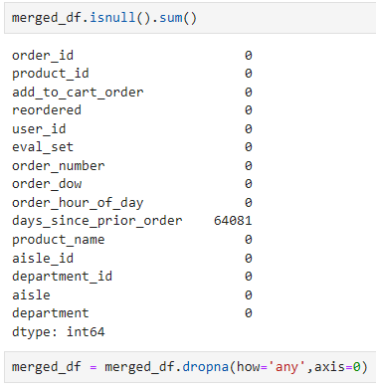

Methodology

Slide 6
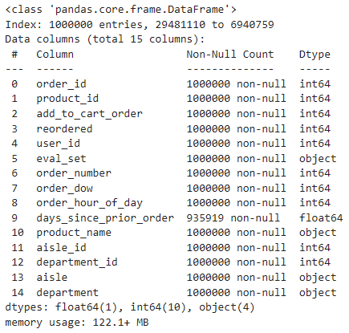
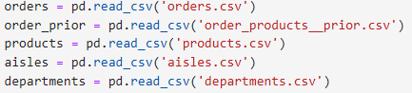
Data Sources & Preprocessing
merged dataframe.info()
Instacart dataset files merged
Instacart Market Basket
public data files
The merged dataset took a sample of 1 million records from the 20M total.
Simulated regions by randomly assigning them (North, East, South, West) based on user_id.
‘Demand’ calculated as the products ordered per ‘region’ by the ‘order_period’ time feature that was also added.
Additional features:
1) demand_lag_1 and demand_lag_2
2) product_mean_demand
MinMaxScaler used for numeric data.
OneHot encoded ‘region’.

Slide 7
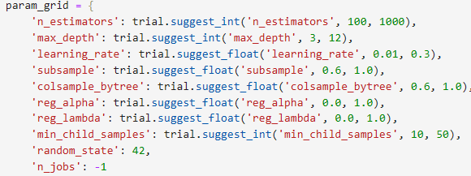

Model LGBMRegressor
LGBM is a gradient boosting ensemble model that improves tree-based learning by utilizing leaf-wise tree growth strategies. This allows the model to look at each leaf and choose the one which reduces loss the most.
LGBM allows for high-speed learning on large scale data, undoubtedly common in real supply chain scenarios.
Optuna was used to tune and optimize hyperparameters of the LGBM model, making sure to take advantage of early_stopping with 20 stopping_rounds to maximize RMSE gain and attempt to reduce overfitting.
Optuna Hyperparameter Grid
Optuna Optimized Parameters

Slide 8

Model Results & Implications
RMSE and MAE error magnitude evaluation:
Low average prediction error once the model reached performance bottleneck in iterations (n_estimators)
about 25 iterations
Model is fit well to this data sample and explains much of the variance (avg 0.95 R²).
Scalability was tested with a stress test on 10M records that will be seen later
1 million sample dataset

Slide 9
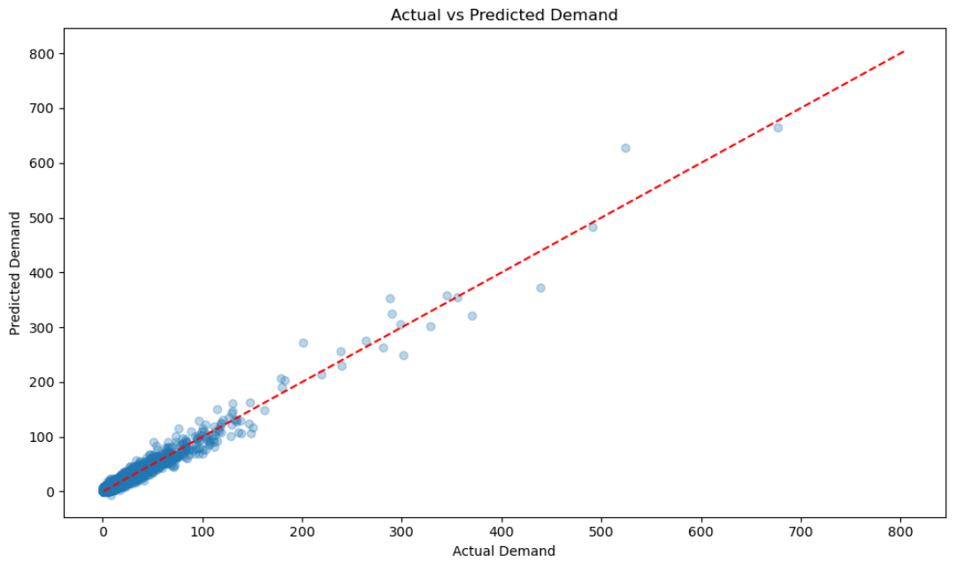
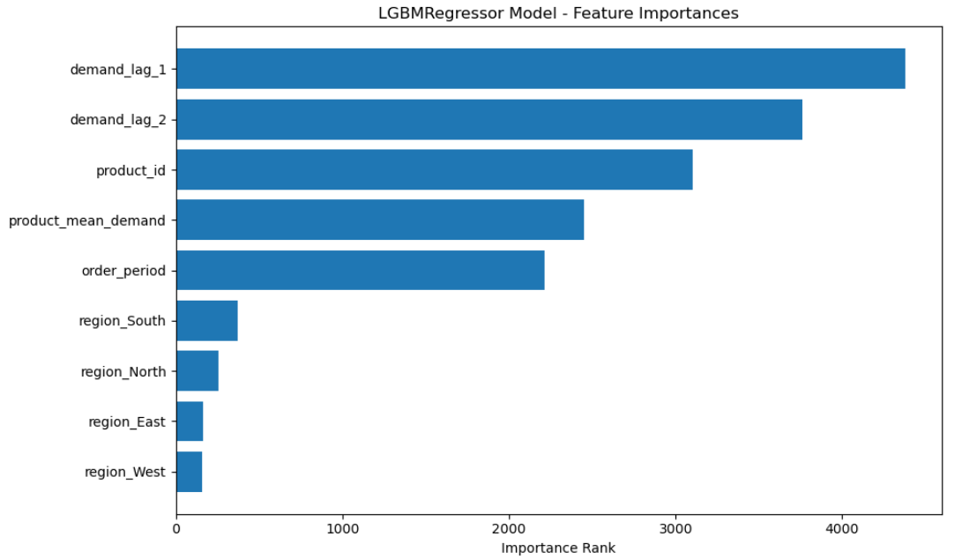
EDA Findings & Methodology Challenges
Interesting Outcomes:
Strong linear trend in actual vs predicted demand
Lagged demand features were extremely helpful in predicting the actual demand, as can often be useful in a timeseries or forecasting type of analysis
Products were also important for predicting demand, along with the mean demand of those products and the order period I estimated them to be sold at
Challenges:
Outliers, however few, and long-tailed product distributions will always pose as obstacles to calibrating a model to accurately predict the min and max ranges of the target variable (demand in this case)
You can see the model prediction faltering near the higher demand values
It was difficult deciding how to approach the product demand and region prioritization scenario with the goal of gaining any meaningful results

Slide 10
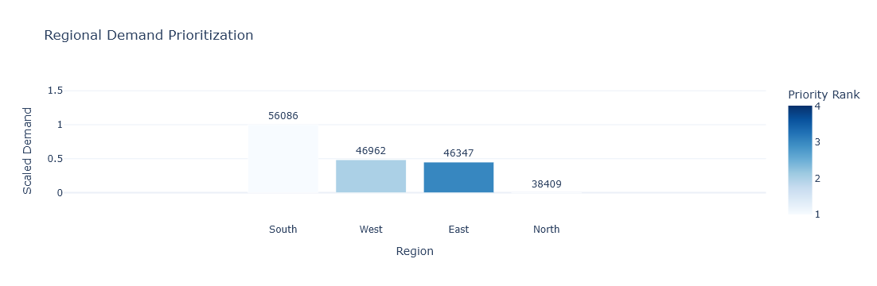
Prioritization Dashboard [Regional Demand]
This example dashboard aims to visualize the ranking of a business’s regions based on their predicted product demands and assign them supply chain efficiency and availability based off that rank.
The demand predictions were grouped by region and normalized (MinMaxScaler) to better depict the difference in priority, or weight, to each region.
The interactive plotly version of this dashboard included in the attached .ipynb file could enable potential stakeholders to visualize regional supply chain pressures and help make business decisions.

Slide 11


Bonus Model [LGBM - 10M Record Stress Test]

Slide 12
Conclusion
This project hopes to demonstrate how businesses could benefit from machine learning models focused on demand forecasting to potentially improve one of the most critical systems of any business or organized movement, the supply chain.
The region simulation across the dataset was something I felt could provide interesting nuance to this kind of analysis and was something I had not done before. Still, it was something I believed could be helpful to any expanded or expanding business.
Taking advantage of calculated timeseries features (such as lagged demand) is extremely useful for any forecasting model and can be used to better capture real-world trends. Collinearity to the target variable is something to always keep in mind when interpreting results for significance and accurately calibrating a potential business response/decision.

